Slide 1


NASA Exoplanet Archive Search
Adam Jarvis & William Leithauser

Slide 2
Project Members
Adam Jarvis
Computer Science
jarvisar@mail.uc.edu
William Leithauser
Computer Science
leithawj@mail.uc.edu
Project Advisor
Dr. Fred Annexstein
annexsfs@ucmail.uc.edu

Slide 3
Project Abstract
The main objective of this project is to develop and build a website capable of querying data from NASA's Exoplanetary Archive using user input. After entering a valid query, the website will build an API URL using the user's input to call NASA's archive and return the requested data. After returning the data, the website will then format the data into a readable form and will give the user the option to export the formatted data to the user's local disk. We will use Angular TypeScript to build the site and utilize HTTP requests and Table Access Protocol (TAP) to call NASA's Archive.
Our Angular-powered Exoplanet Archive Search simplifies the process of querying and retrieving data from NASA's exoplanet database, providing an intuitive and responsive experience with enhanced readability and user interaction.

Slide 4

User Stories
As a user, I want to input a search query so that I can view planetary data from NASA's Exoplanet Archive.
As a novice astronomer, I want to learn what each piece of data means/represents so I can better understand the data.
As a user, I want to be able to filter the data within the table so I can better find the data I need.
As a researcher, I want to export the returned data so that I can use the returned data elsewhere, such as academic projects.
As a user, I want to be able to add or remove table columns so the table is more readable and accessible.
As a developer, I want to use responsive styling and design so the website is interactive and easy to use.
As a user, I want additional details about each exoplanet to be available so that I can learn more about specific exoplanets.
As a researcher, I would like to see the data source to ensure the returned data is accurate and up to date.
As a user, I would like a button to clear cache to manually refresh the data.

Slide 5
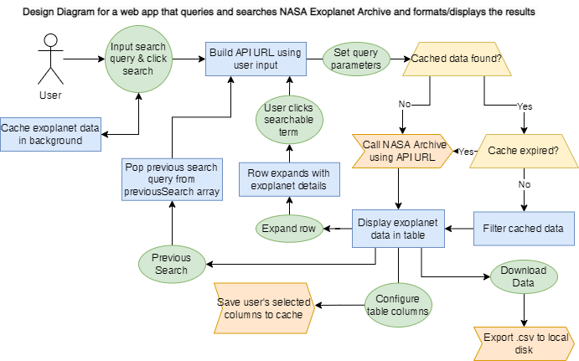
Design Diagram

Slide 6



Technologies & Stack
This web app was built using Angular 14 and is a Progressive Web App (PWA) that can be installed on most devices with a modern browser
This project utilizes Table Access Protocol (TAP) to request and return data from the Exoplanet Archive. TAP is a protocol developed by IVOA that allows access and querying of table data on remove servers (primarily astronomical data)
This project also uses by Express.js CORS Proxy to add the necessary headers to the HTTP response from the Exoplanet Archive

Slide 7
Development Process
Step 1
Initial web design and API testing
Step 2
Build core UI elements such as input and table
Step 3
Test and enhance performance and functionality
Step 4
Implement responsive styling and dynamic sizing

Slide 8
Core Project Layout
Name | Type | Function
App | Component | Root component and container
InputBar | Component | HTML, CSS, and JavaScript for input-bar elements
Data Service | Service | Used to call the Exoplanet Archive and return/cache data
Table | Component | Angular component for data table (includes table buttons & paginator)
Exodetail | Component | Angular component for expanded exoplanet row (includes Aladin visualization)
Loading & Interceptor | Service | HTTP interceptor used to conditionally render the loading spinner in AppComponent
Sort & Resize | Directive | Used to enable sorting and resizing on table headers in table component
Download | Service | Converts current table data to .csv format and exports to user’s local disk

Slide 9
Implemented Features
Material Design
Material Design is used throughout the web application giving it a consistent and modern look and feel
Interactive Table
Aladin Lite Sky Atlas
Expand an exoplanet’s row to view its position in Aladin Lite's interactive sky visualization.
Table headers are sortable and resizable, with the ability to configure which columns are displayed.
Progressive Web App Support
PWA’s are web applications designed to function like a native app on mobile devices and desktops.
Streamlined Data Retrieval
With pagination and conditional rendering, the table loads instantly once exoplanet data is cached in the background.
Exportable Data
Use the download button to export the table data to the local disk in .csv format

Slide 10
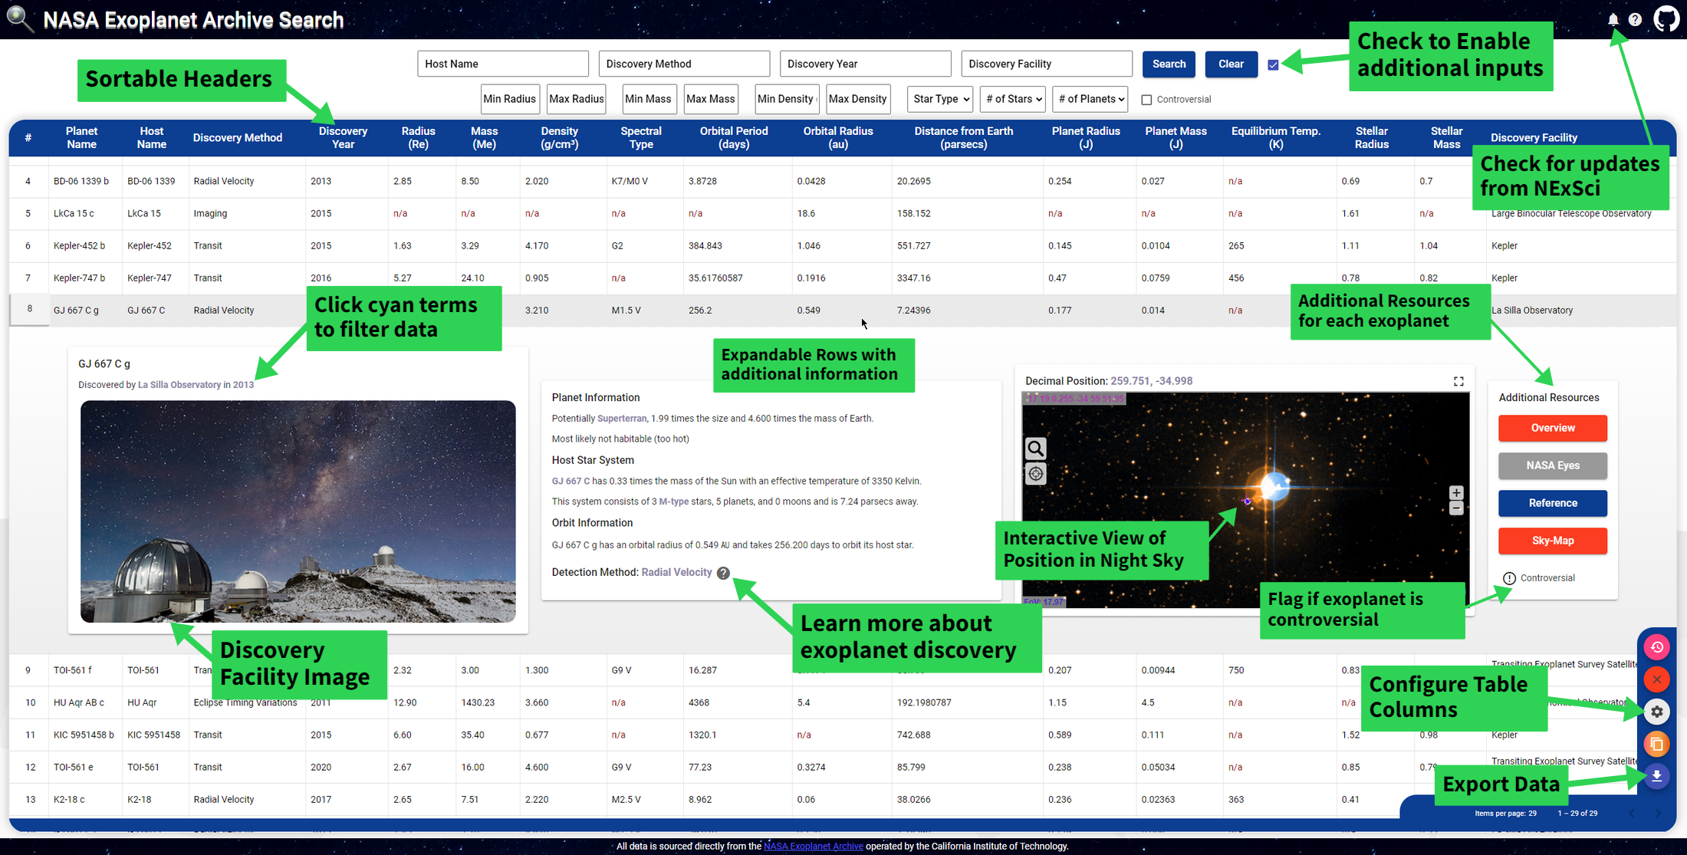
Final UI Layout

